Slide 1
Tauranga Test Professionals Meetup – November 2024
Survey Results

Slide 2
Response Summary
14 responses in total
0 questions skipped
Average completion time = 1 minute 22 seconds

Slide 3
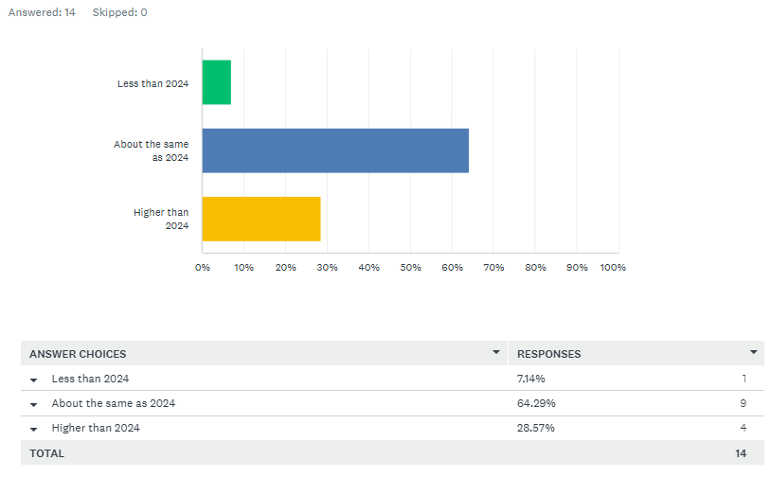
In 2025, do you think that your organisation’s project workload will be:

Slide 4
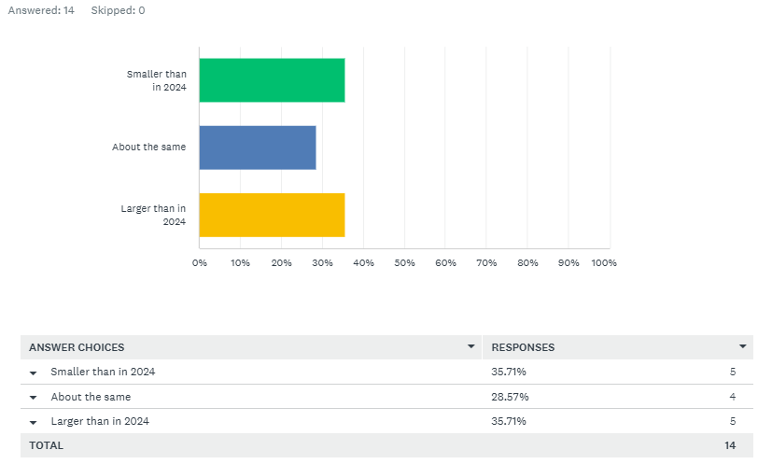
In 2025, do you think your organisations project delivery team will be:

Slide 5
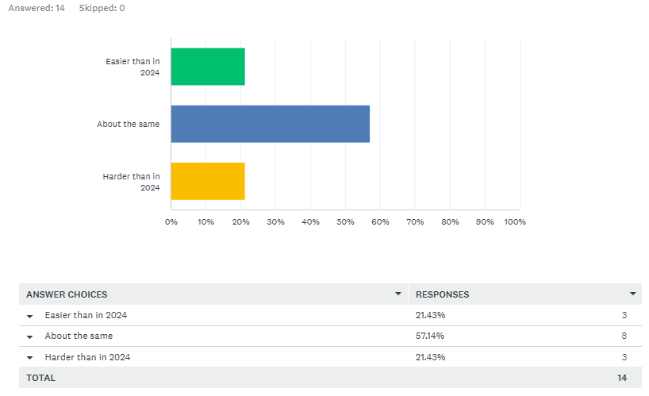
In 2025, do you think the difficulty in hiring staff will be:

Slide 6
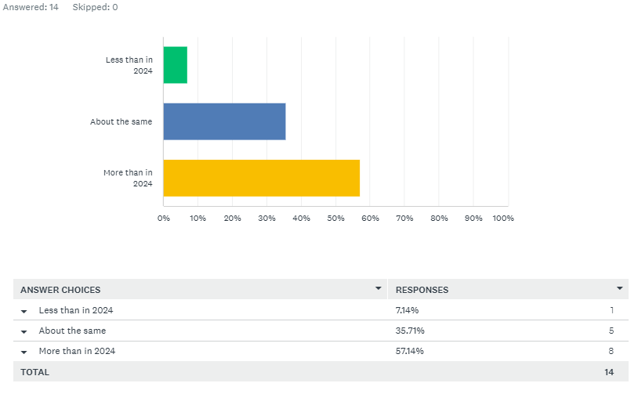
In 2025, do you think that your use of Test Automation will be:

Slide 7
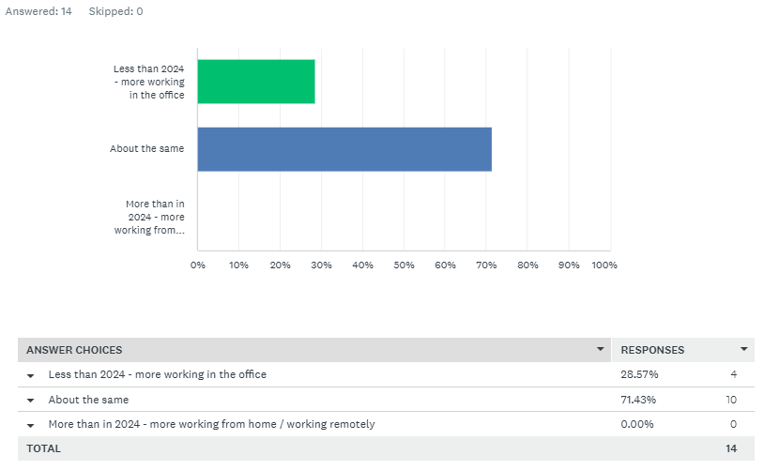
In 2025, do you think remote working / working from home will be:

Slide 8
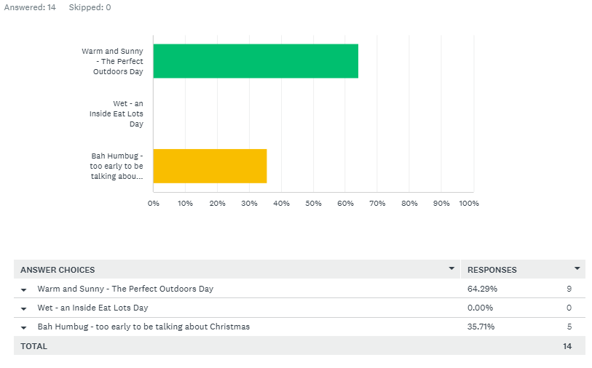
Christmas Day 2024 will be:

Slide 9
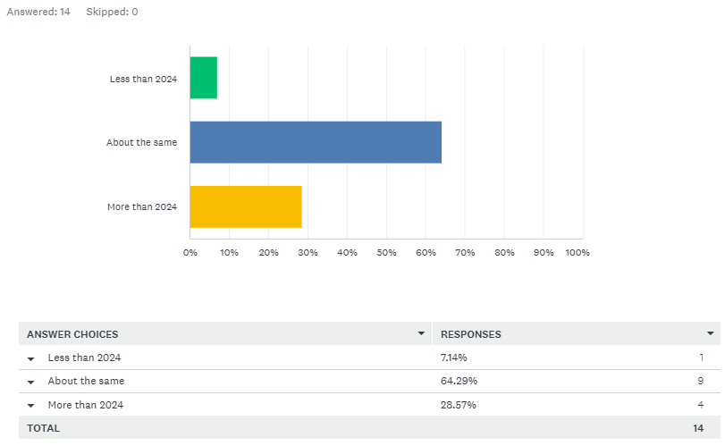
In 2025, do you think that the sunshine hours for Tauranga will be:

Slide 10
Tauranga Test Professionals Meetup – November 2024
Survey Results

