Slide 1
Tauranga Test Professionals Meetup – December 2023
Survey Results

Slide 2
Response Summary
15 responses in total
0 questions skipped
Average completion time = 57 seconds

Slide 3
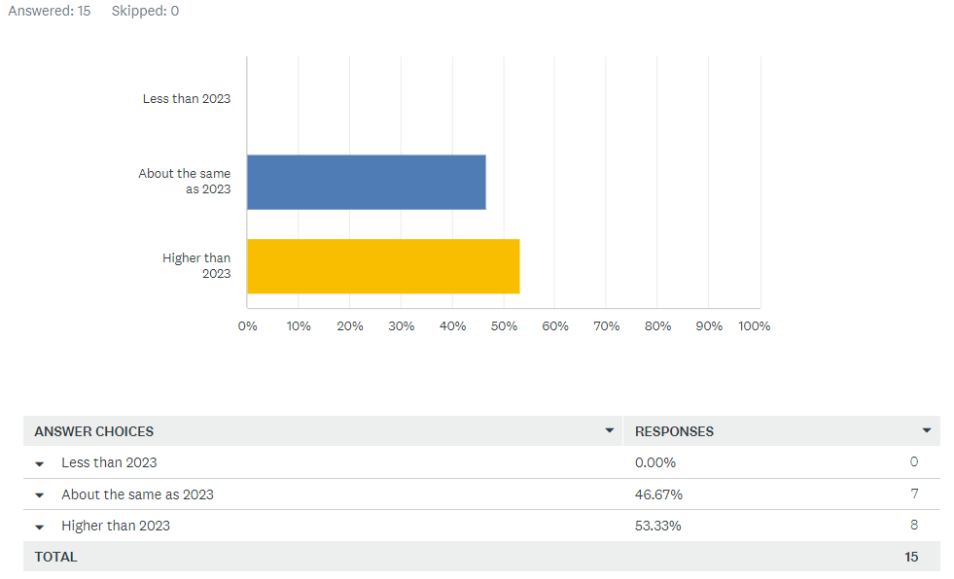
In 2024, do you think that your organisation’s project workload will be:

Slide 4
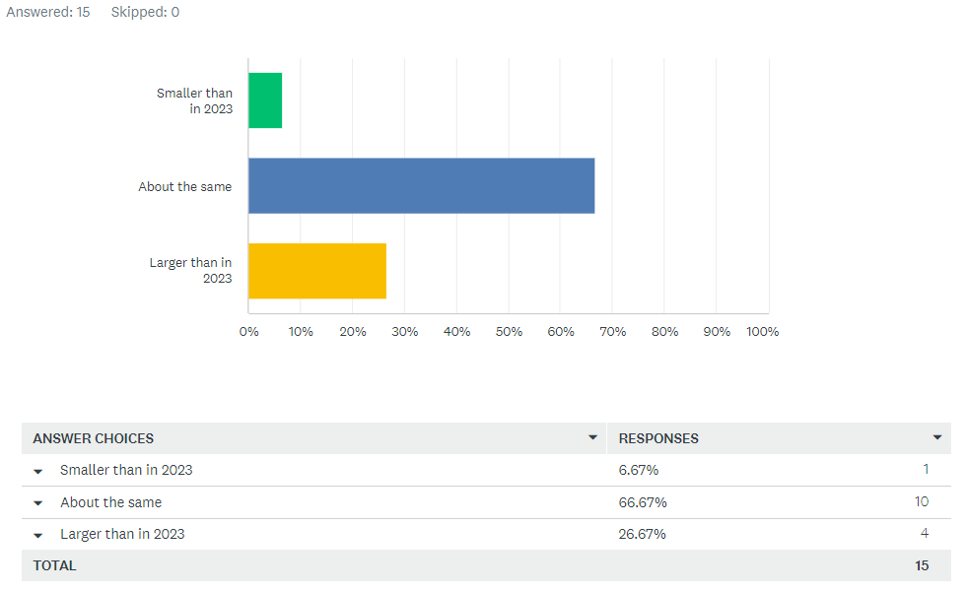
In 2024, do you think your organisations project delivery team will be:

Slide 5
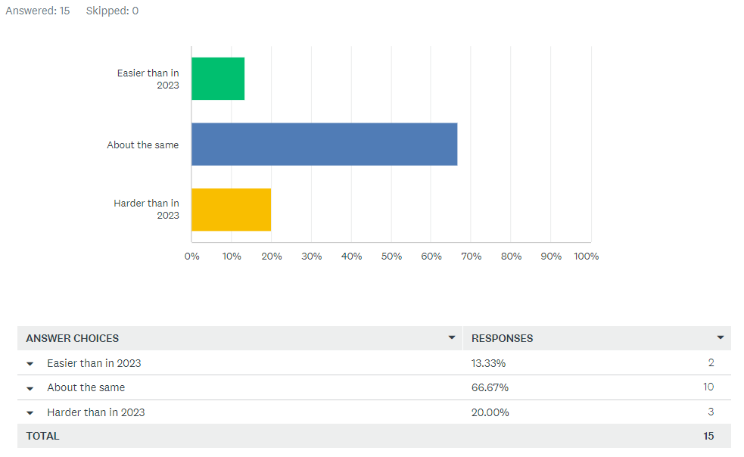
In 2024, do you think the difficulty in hiring staff will be:

Slide 6
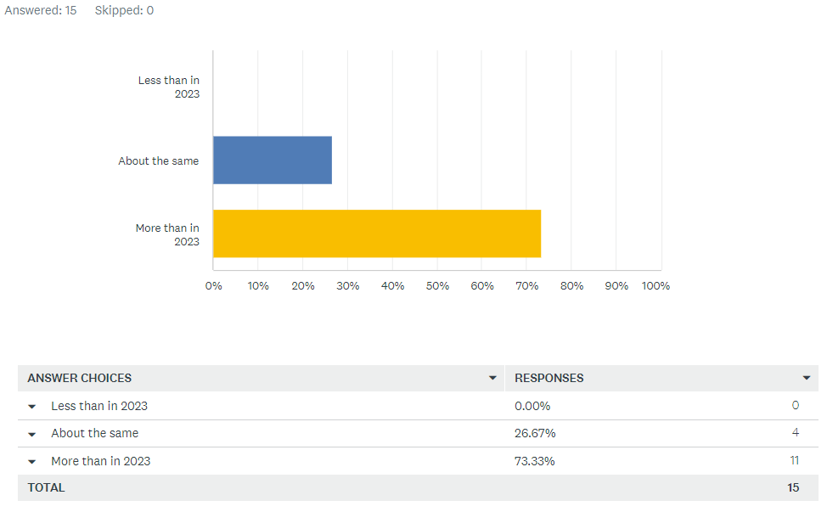
In 2024, do you think that your use of Test Automation will be:
5th December 2023

Slide 7
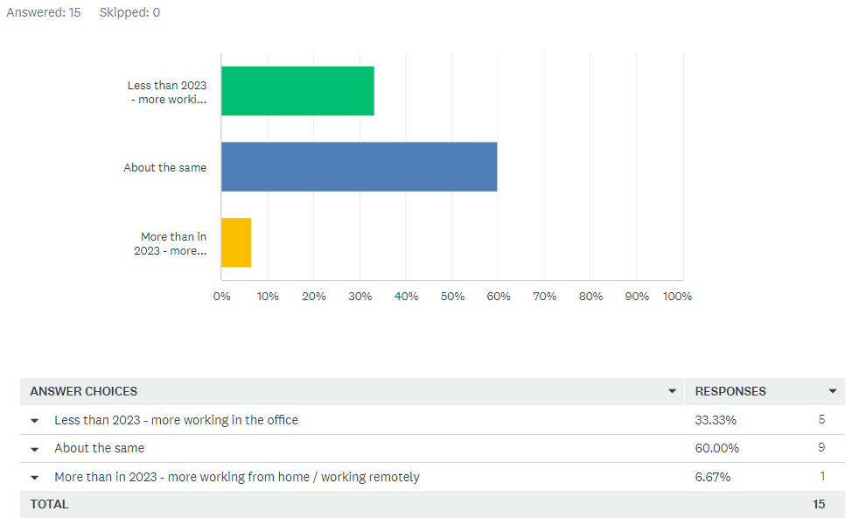
In 2024, do you think remote working / working from home will be:

Slide 8
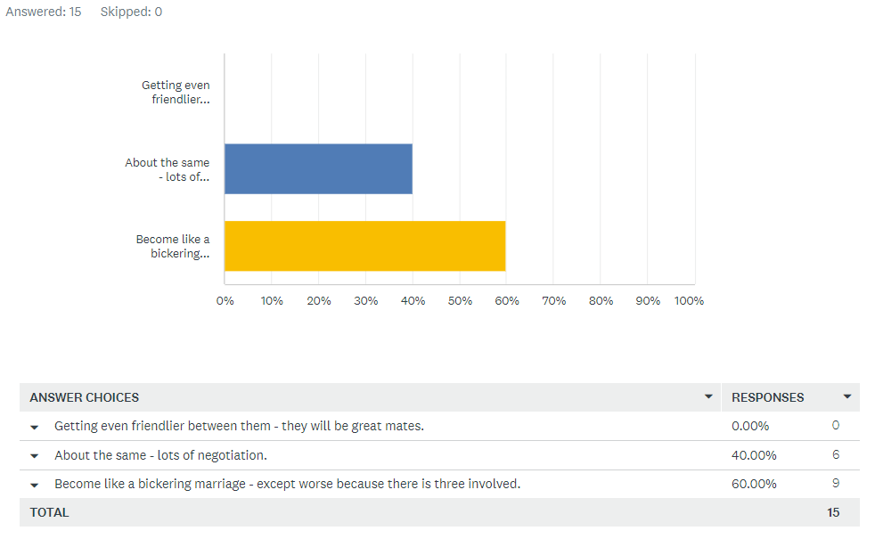
In 2024, do you think that the Parliament Coalition of the Three Amigos will be:

Slide 9
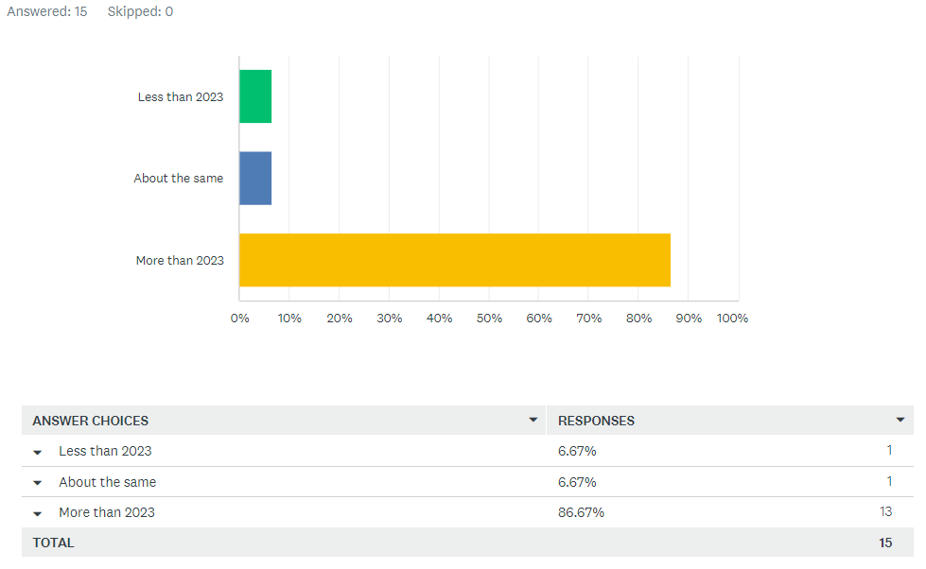
In 2024, do you think that the sunshine hours for Tauranga will be:

Slide 10
Tauranga Test Professionals Meetup – December 2023
Survey Results

